Slide 1
The Processor
Prepared by Dr. Andrew Jung

Slide 2
Introduction
CPU performance factors
Instruction count
Determined by ISA and compiler
CPI and Cycle time
Determined by CPU hardware
We will examine two MIPS implementations
A simplified version
A more realistic pipelined version
Simple subset, shows most aspects
Memory reference: lw, sw
Arithmetic/logical: add, sub, and, or, slt
Control transfer: beq, j

Slide 3
Instruction Execution
PC → instruction memory, fetch instruction
Register numbers → register file, read registers
Depending on instruction class
Use ALU to calculate
Arithmetic result
Memory address for load/store
Branch target address
Access data memory for load/store
PC ← target address or PC + 4

Slide 4
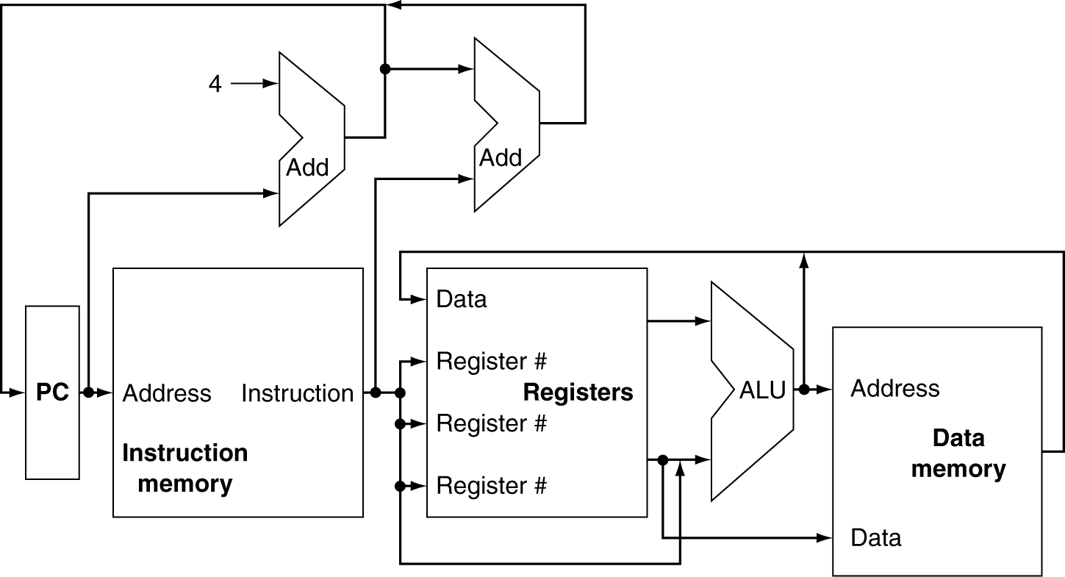
CPU Overview

Slide 5
Multiplexers
Can’t just join wires together
Use multiplexers

Slide 6
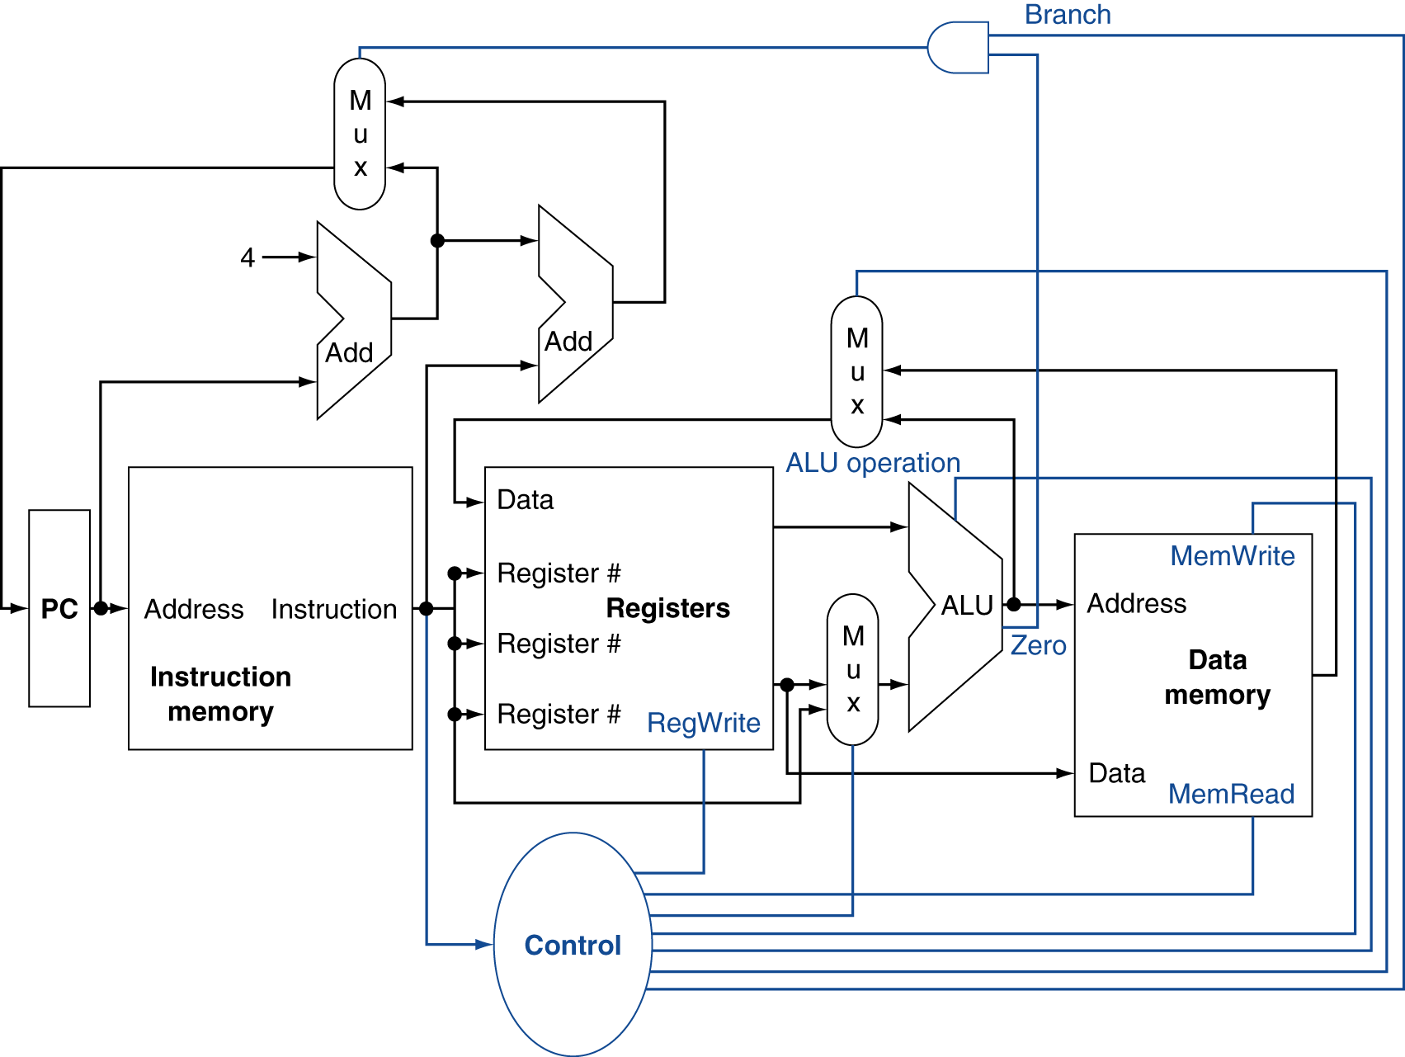
Control

Slide 7
Logic Design Basics
Information encoded in binary
Low voltage = 0, High voltage = 1
One wire per bit
Multi-bit data encoded on multi-wire buses
Combinational element
Operate on data
Output is a function of input
State (sequential) elements
Store information

Slide 8
Combinational Logic
A logic system whose blocks do not contain memory and hence compute the same output given the same input.
Truth table
describe any combinational logic function.
It grows in size quickly and may not be easy to understand.

Slide 9
Truth Table
Three inputs A, B, C, and three outputs D, E, and F.
D is true if at least one input is true.
E is true if exactly two inputs are true.
F is true only if all three inputs are true.
Inputs |  |  | Outputs
A | B | C | D | E | F
0 | 0 | 0 | 0 | 0 | 0
0 | 0 | 1 | 1 | 0 | 0
0 | 1 | 0 | 1 | 0 | 0
0 | 1 | 1 | 1 | 1 | 0
1 | 0 | 0 | 1 | 0 | 0
1 | 0 | 1 | 1 | 1 | 0
1 | 1 | 0 | 1 | 1 | 0
1 | 1 | 1 | 1 | 0 | 1

Slide 10
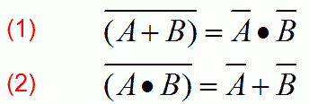
Boolean Algebra
OR operator: +
And operator: ∙
NOT operator: Ᾱ
Express the logic function with logic equation.
Identity Law: A + 0 = A and A ∙ 1 = A
Zero and One laws: A + 1 = 1 and A ∙ 0 = 0
Inverse Law: A + Ᾱ = 1 and A ∙ Ᾱ = 0
Commutative law: A + B = B + A and A ∙ B = B ∙ A
Associative law: A + (B + C) = (A + B) + C and A ∙ (B ∙ C) = (A ∙ B) ∙ C
Distributive Law: A ∙ (B + C) = (A ∙ B) + (A ∙ C) and A + (B ∙ C) = (A + B) ∙ (A +C)
DeMorgan’s Theoreum:

Slide 11
Logic Equation
D = A + B + C
E = ((A ∙ B) + (A ∙ C) + (B ∙ C)) ∙
F = A ∙ B ∙ C

Slide 12

Gates
Standard drawing for an AND gate, OR gate, and an inverter, shown from left to right. The signals to the left of each symbol are the inputs, while the output appears on the right. The AND and OR gates both have two inputs. Inverters have a single input.

Slide 13

Gates
Logic gate implementation of using explicit inverts on the left and bubbled inputs and outputs on the right. This logic function can be simplified to

Slide 14
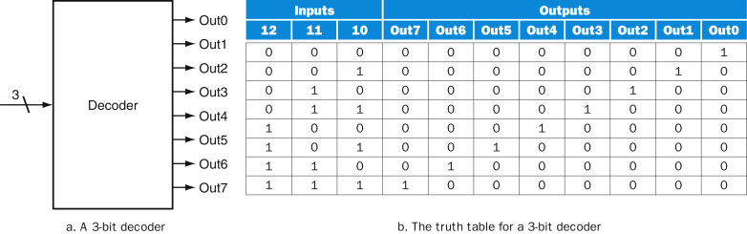
Combinational Logic
Decoders
A logic block that has an n-bit input and 2^{n} outputs, where only one output is asserted for each input combination.

Slide 15
Multiplexors
Selector
Three parts
A decoder that generates n signals, each indicating a different input value.
An array of n AND gates, each combining one of the inputs with a signal from decoder.
A single large OR gate that incorporates the outputs of the AND gates.

Slide 16
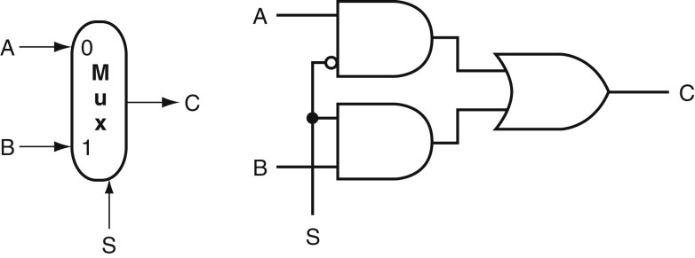
Multiplexors
A two-input multiplexor on the left and its implementation with gates on the right. The multiplexor has two data inputs (A and B), which are labeled 0 and 1, and one selector input (S), as well as an output C. Implementing multiplexors in Verilog requires a little more work, especially when they are wider than two inputs.

Slide 17
Sum of products
A form of logical representation that employs a logical sum(OR) of products(terms joined using the AND operator)

Slide 18
Sum of products
Show the sum of products representation for the following truth table for D.
Inputs |  | Outputs
A | B | C | D
0 | 0 | 0 | 0
0 | 0 | 1 | 1
0 | 1 | 0 | 1
0 | 1 | 1 | 0
1 | 0 | 0 | 1
1 | 0 | 1 | 0
1 | 1 | 0 | 0
1 | 1 | 1 | 1

Slide 19
Sum of products
There are four product terms, since the function is true(1) for four different input combination.
Thus, we can write the function for D as the sum of these:

Slide 20
Activity
On Blackboard…

